Slide 1










Shared licenses from network zone and POLs in member institutions
Yoel Kortick. Senior Librarian
http://www.julac.org/

Slide 2


Introduction
Adding the shared license in Network Zone
Distributing shared licenses to member institutions
Using the shared license in the member institution
text
https://slidemodel.com/templates/animated-rainbow-business-powerpoint-template/
http://image.shutterstock.com/z/stock-photo-business-hand-writing-blank-agenda-list-130255148.jpg

Slide 3
Introduction
This feature deals with Acquisition Networks that manage shared licenses.
With this feature the licenses are created and managed in the network zone and shared with the member institutions.
Each member institution orders whatever resources it wants for whatever price it wants using whatever license it wants.
While the license is managed in the network and shared with the member institutions, each member institution can create it’s own amendment which typically includes license terms unique to the member institution.
URM-60366

Slide 4
Introduction
Adding the shared license in Network Zone
Distributing shared licenses to member institutions
Using the shared license in the member institution
text
https://slidemodel.com/templates/animated-rainbow-business-powerpoint-template/
http://image.shutterstock.com/z/stock-photo-business-hand-writing-blank-agenda-list-130255148.jpg

Slide 5

Adding the shared license in Network Zone
From within the network zone add a license using menu ‘Acquisitions > Acquisitions Infrastructure > Licenses > Add’
Check the box “Shared License”
On the next screen we will see shared license “French Feminist Publications” with code “FFP”

Slide 6
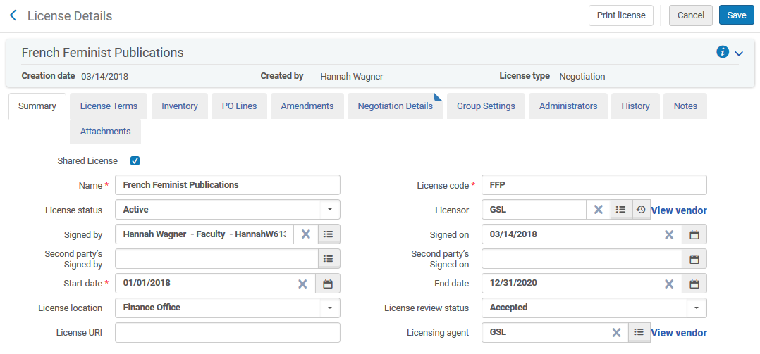
Adding the shared license in Network Zone

Slide 7
Adding the shared license in Network Zone
Selecting “Shared License” allows the network to push the license to all member institutions, enabling each one to purchase resources and attach them to their local copy of the license.
The Shared License is pushed to the members either
  The next time that the “Distribute Network Acquisition Changes to Members” job runs
  When the staff user does “Actions > Distribute to Member” on the specific license

Slide 8
Introduction
Adding the shared license in Network Zone
Distributing shared licenses to member institutions
Using the shared license in the member institution
text
https://slidemodel.com/templates/animated-rainbow-business-powerpoint-template/
http://image.shutterstock.com/z/stock-photo-business-hand-writing-blank-agenda-list-130255148.jpg

Slide 9
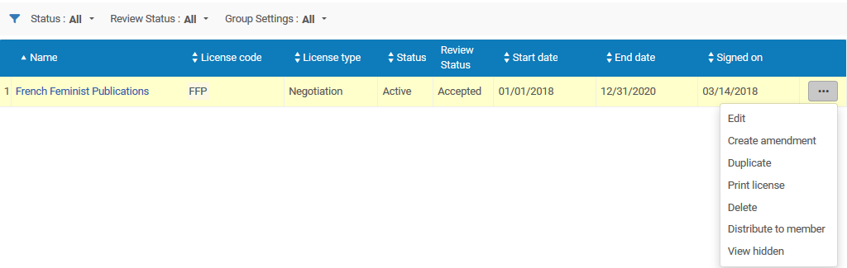
Distributing shared licenses to member institutions
To manually distribute a specific shared license to a member institution choose “actions > distribute to member” from the list of licenses.

Slide 10
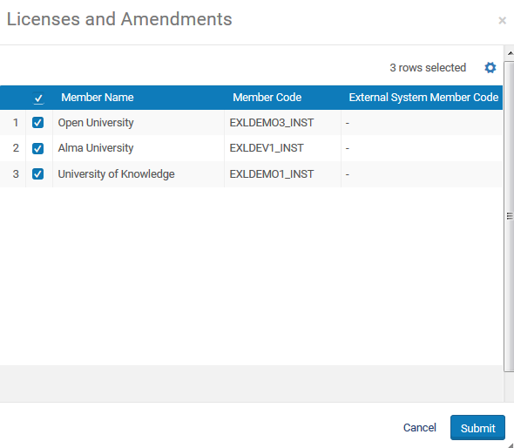
Distributing shared licenses to member institutions
The staff user can then choose to distribute to all members or only to specific members. Here we have chosen all members.

Slide 11
Distributing shared licenses to member institutions
Clicking “submit” runs the job “Distribute network Acquisition changes to members”

Slide 12
Introduction
Adding the shared license in Network Zone
Distributing shared licenses to member institutions
Using the shared license in the member institution
text
https://slidemodel.com/templates/animated-rainbow-business-powerpoint-template/
http://image.shutterstock.com/z/stock-photo-business-hand-writing-blank-agenda-list-130255148.jpg

Slide 13
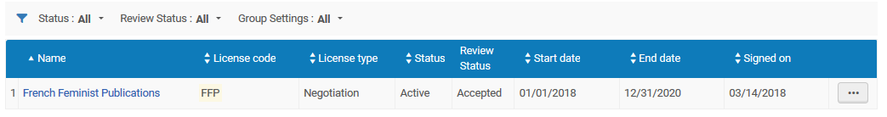
Using the shared license in the member institution
In the member institution all shared licenses have a check box in the “Shared” column of the list of licenses.
Here is license code FFP in the network
Here is the license in member institution “Alma University”

Slide 14
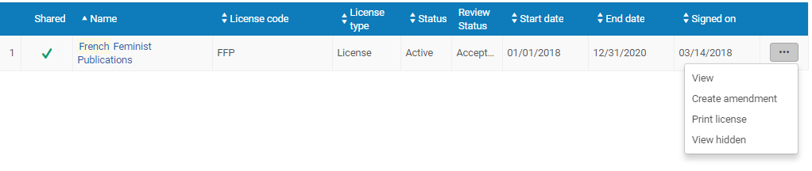
Using the shared license in the member institution
In the member institution the license can be viewed but not edited. It is edited only in the network institution.
In member institution the license can be viewed but not edited.

Slide 15
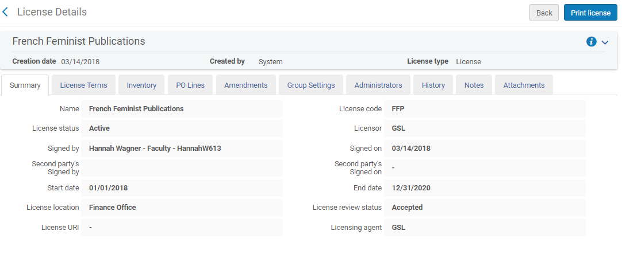
Using the shared license in the member institution
When viewing the license in the member institution all fields are “view only”.
The information in the ‘Summary’ and ‘License Terms’ tabs are shared with the member from the network

Slide 16
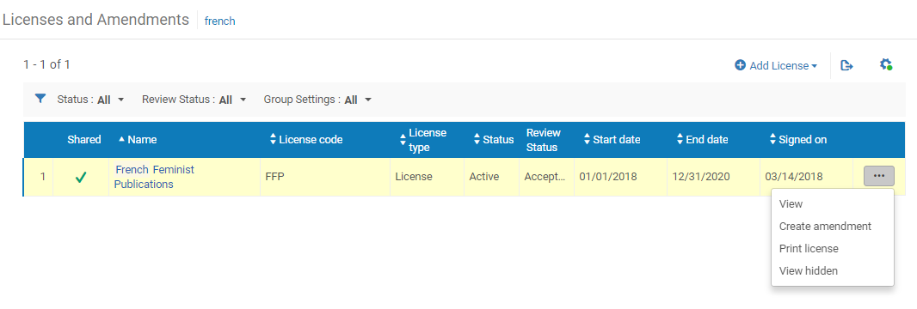
Using the shared license in the member institution
It is possible however in the member institution to create an amendment to the shared license in the network
The amendment will modify the properties of the base license.
Amendments added to a license override the base license.

Slide 17
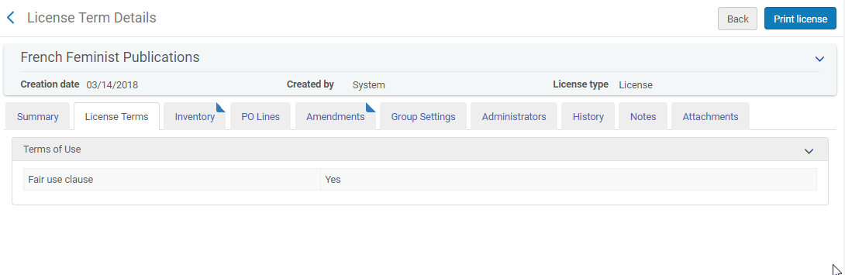
Using the shared license in the member institution
For example, the shared license code FFP has no "Walk in User Note" or "Citation requirement detail"

Slide 18
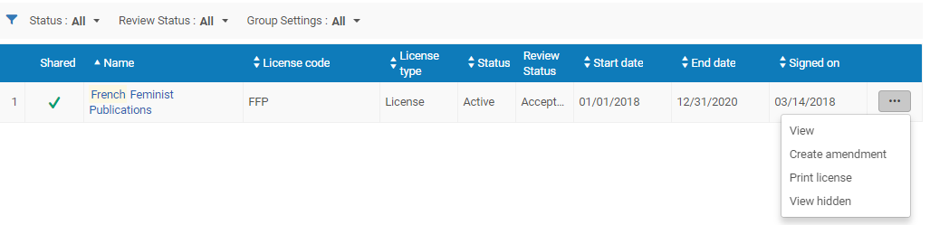
Using the shared license in the member institution
For vendor code FFP we will choose “Create Amendment” in the member institution

Slide 19
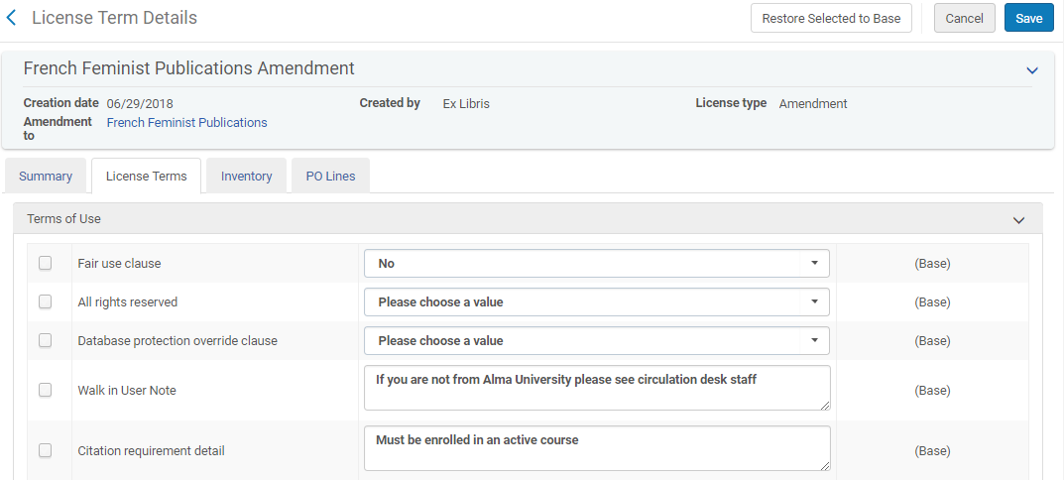
Using the shared license in the member institution
In the amendment we will add a "Walk in User Note" and "Citation requirement detail“ to the “License Terms”.

Slide 20
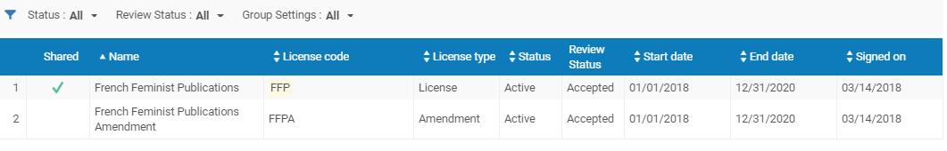
Using the shared license in the member institution
Now we have the shared license with the “shared” checkmark and also the amendment.

Slide 21
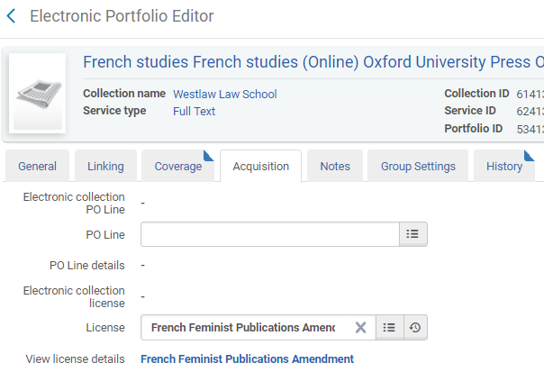
Using the shared license in the member institution
The amendment or the shared license can be attributed to any resource. Here we have attributed the amendment to license code FFP to resource “French studies”

Slide 22

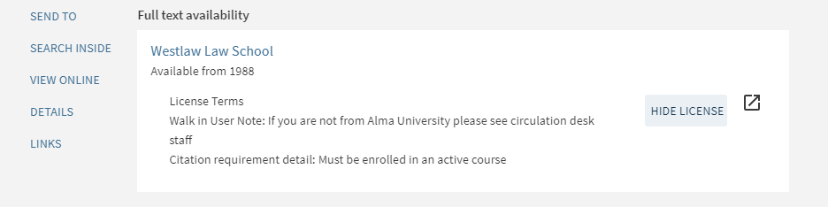
Using the shared license in the member institution
When we view this in discovery within scope of member institution we see the license terms of the amendment

Slide 23
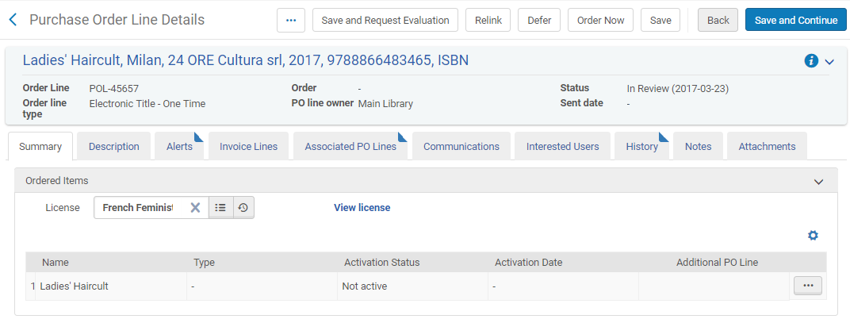
Using the shared license in the member institution
In the previous example we saw that the shared license or the amendment can be attributed directly to a resource in the member institution.
It is also possible to add the shared license or amendment to a POL

